Slide 1
EU CYBER INCIDENTS IMPACT
BASED ON THE DATASET 2019-2024

Slide 2
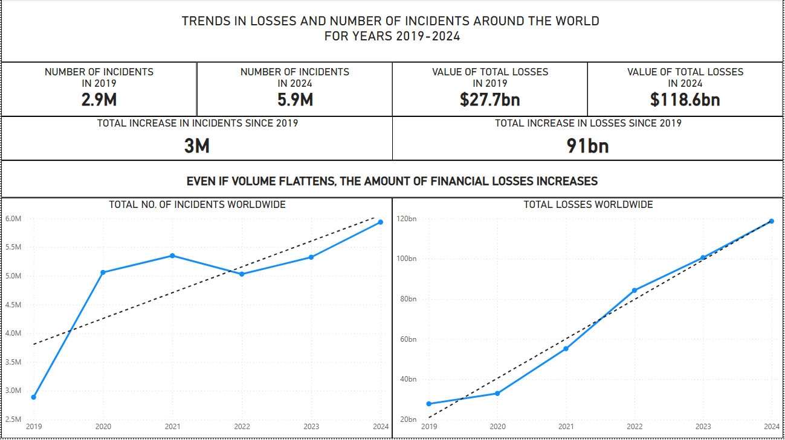
TRENDS WORLDWIDE

Slide 3
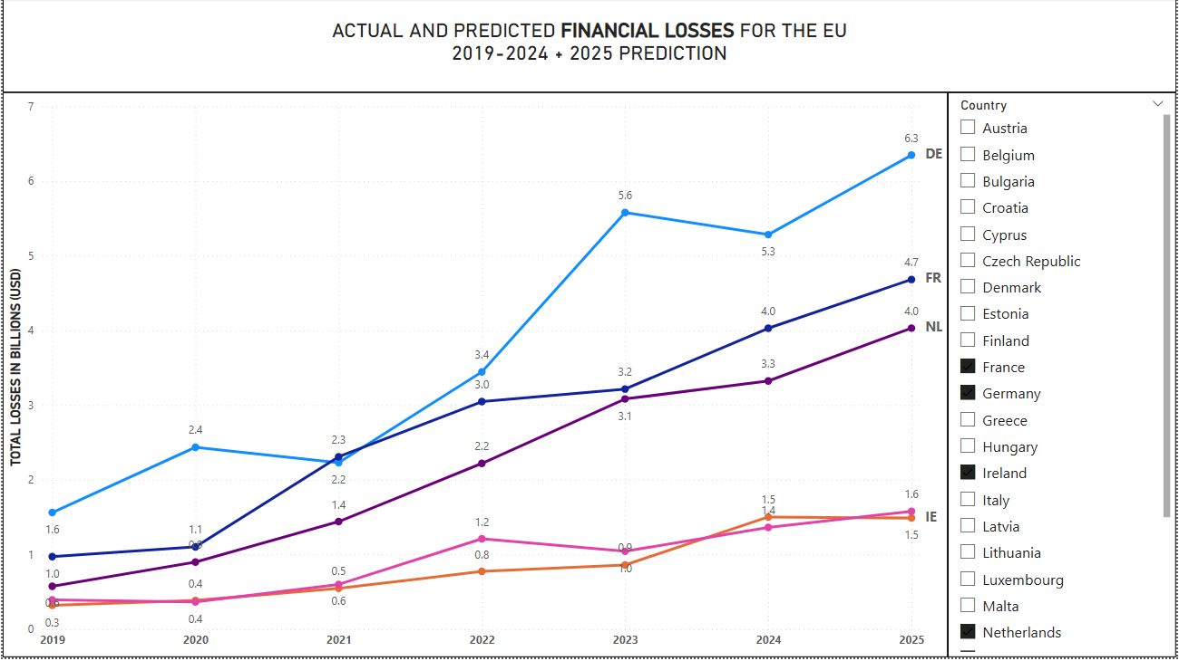
TRENDS IN EUROPE

Slide 4
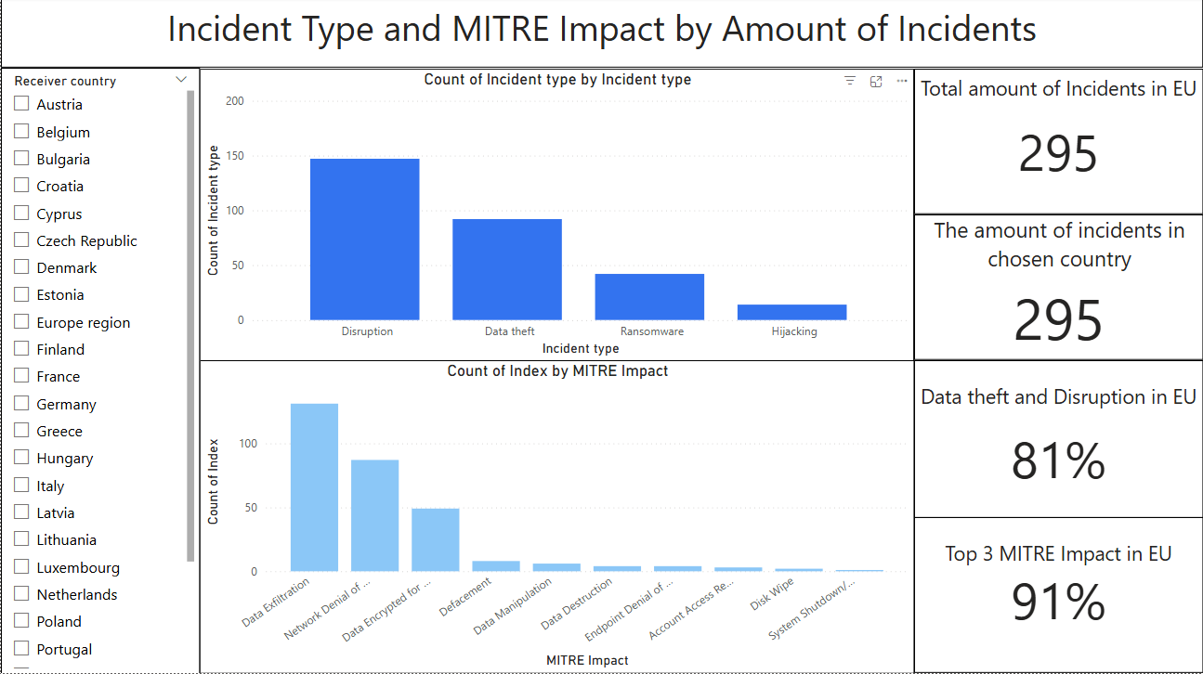
INCIDENT TYPE BY AMOUNT

Slide 5
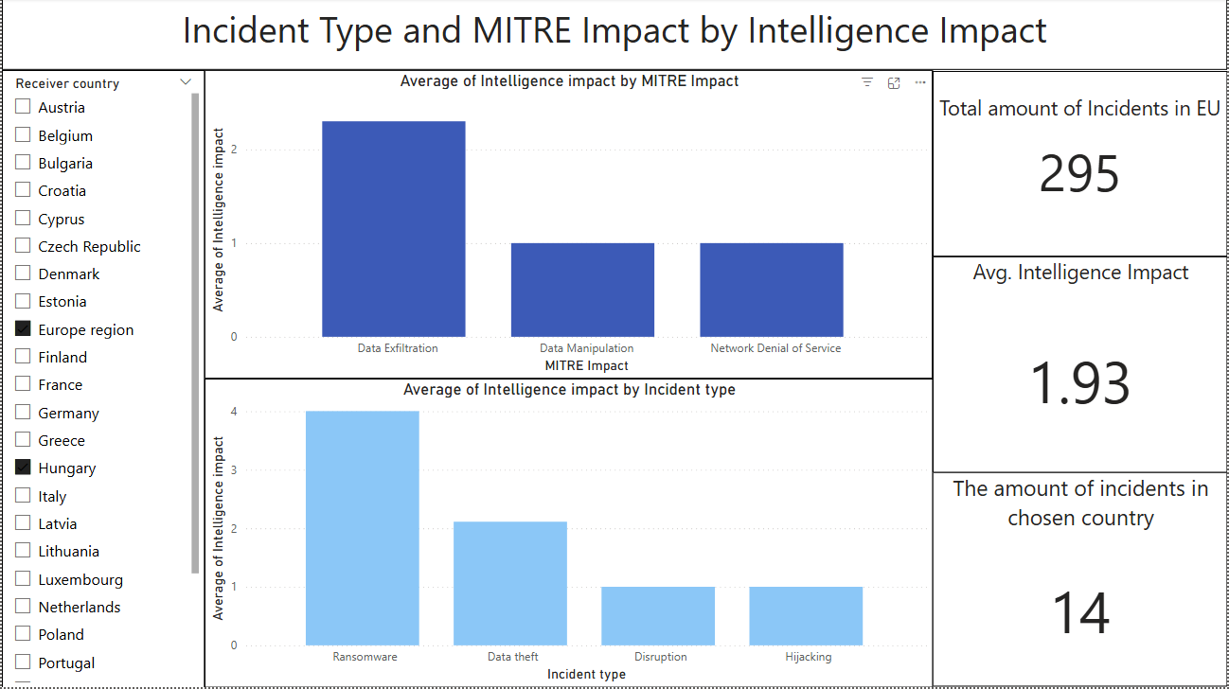
INCIDENT TYPE BY IMPACT

Slide 6
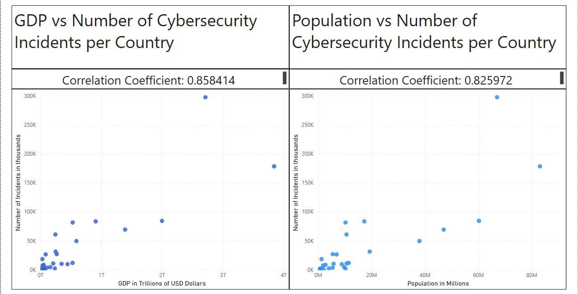
CORRELATIONS BETWEEN GPD/POPULATION AND INCIDENTS

Slide 7

WHY THIS RESEARCH?
LOSSES AND INCIDENTS ARE RISING GLOBALLY
MORE INCIDENTS = MORE FINANCIAL LOSS
PREDICTIONS SHOW THAT THE SITUATION WILL GET WORSE
WE CAN REDUCE THE AMOUNT OF LOSS BY INVESTING INTO CYBER DEFENSE
IF WE DON’T ACT, WE WILL LOSE ON AVERAGE ADDITIONAL $2bln USD YEAR-TO-YEAR PER COUNTRY
FROM OUR ANALYSIS WE CAN TELL WHAT TYPES OF CYBER ATTACKS YOU CAN FOCUS ON TO MITIGATE THE IMPACT AND SAVE MONEY
WHAT ARE THE BIGGEST IMPACTS WHAT TYPES OF ATTACKS HAPPEN MOST OFTEN IN EU AND HOW TO PREPARE

